Slide 1
A Scheme for Factoid Question Answering Over Knowledge Base
DEIM 2019 G7- 5
Happy BUZAABA, Toshiyuki AMAGASA
2019 - 03 - 06
KDE-LAB
UNIVERSITY OF TSUKUBA

Slide 2
Outline
Introduction
Motivation
Related work
Objective
Approach
Results
Conclusion & Future work
A Scheme For Factoid Question Answering over Knowledge Base
March 6, 2019

Slide 3
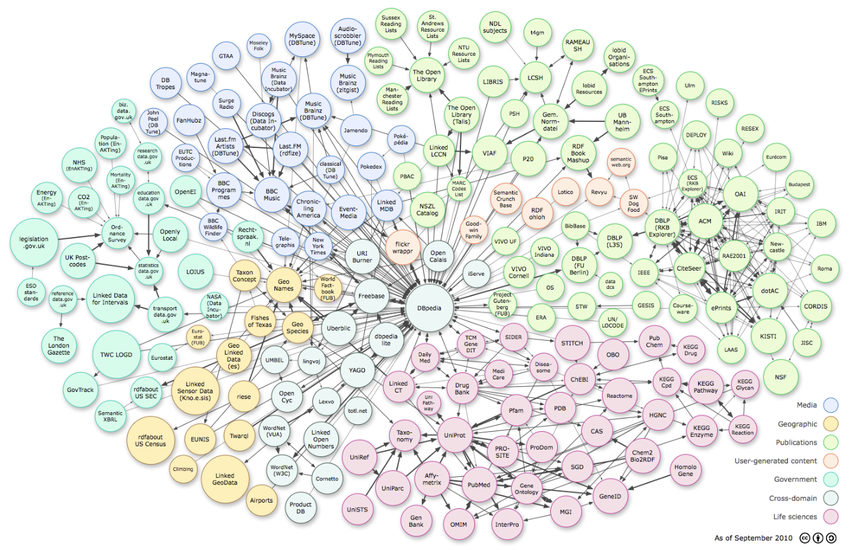
Knowledge Bases
A Scheme For Factoid Question Answering over Knowledge Base
Merch 6, 2019

Slide 4
RDF_graph
(Subject, Relation, Object)
Ex Machina
The Tesseract
author
director
directed_by
written_by
spouse_s
Alex Garland
film
Dredd
Paloma Baeza
Child
has_spouse
Parent
Parent
Type_of_union
Nocholas Garland
Marriage
Eva Garland
Grand_Child
SPARQL query
Out put
PREFIX: <http://bedrock/>
SELECT ?subject ?predicate ?object
WHERE {?subject ?predicate ?object}
Subject Predicate Object
Alex Garland director Ex Machina
Ex Machina directed_by Alex Garland
The Tesseract author Alex Garland
Paloma Baeza has_spouse Alex Garland
A Scheme For Factoid Question Answering over Knowledge Base
March 6, 2019

Slide 5
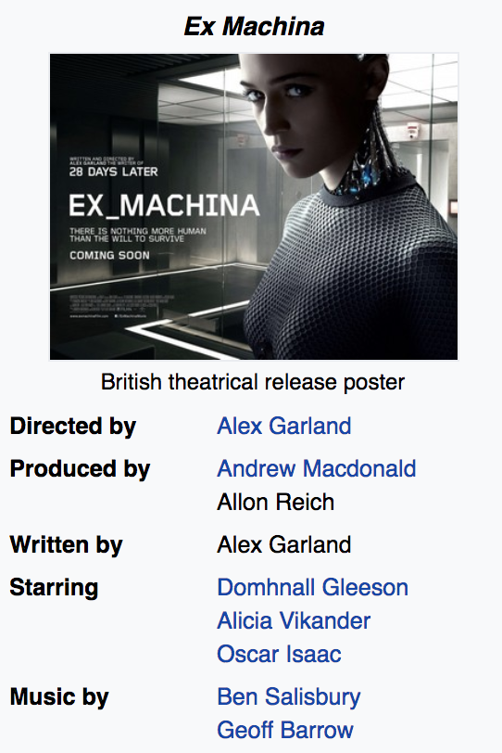

Knowledge base question answering
What else did the director of the movie Ex Machina direct?
Semantic Parsing
select ?y
fb:m.0fkf28
fb:object.type
fb:film.film
fb:m.0fkf28
fb:film.film.directed_by
?y
?x
fb:film.director.film
?y
?y
fb:object.type
fb:film.film
Annihilation 28 Days Later Sunshine
Never let Me Go Dredd
A Scheme For Factoid Question Answering over Knowledge Base
March 6, 2019

Slide 6
Task definition
Question:
Where was Barack Obama born?
Formal definition:
1 – Subject: Barack Obama
1 – Relation: place_of_birth
KB_execution:
USA
The audacity of hope
8/04/1961
bornOn
President _of
Leader
authored_by
home_to
spouse_s
Barack Obama
Hawaii
Place_of_birth
Michelle Obama
has_spouse
origin
Parent
daughter_to
Kenya
Sasha Obama
Candidate triple:
(‘Barack Obama’; ‘place_of_birth’; ‘Hawaii’)
A Scheme For Factoid Question Answering over Knowledge Base
March 6, 2019

Slide 7
Motivation

Slide 8
Motivation
Simple questions are commonly used in web search, voice assistants, chatbots etc.
Availability of a large simple questions benchmark of 108, 442 questions.
The simple questions benchmark is far from being solved with
(76.4% state-of-the-art)
A Scheme For Factoid Question Answering over Knowledge Base
March 6, 2019

Slide 9
Related work

Slide 10
Related work
Memory networks (Bodes et al., 2015)
Generalization Map
Weighted sum
Output Map
Dotproduct + Softmax
{f₁, f₂,..,f_{|kb|}}
{c₁}
Input Map
Knowledge Base
Question
Response
A Scheme For Factoid Question Answering over Knowledge Base
March 6, 2019

Slide 11
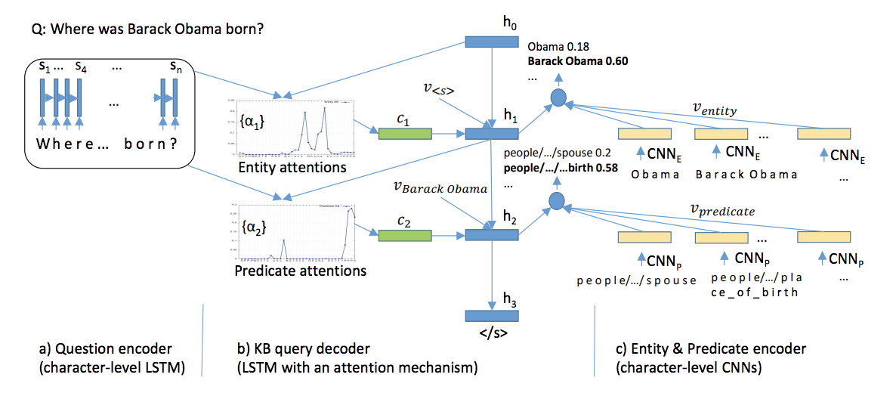
Related work
Character-level attention-based Encoder-Decoder (Golub & He, 2016)
A Scheme For Factoid Question Answering over Knowledge Base
March 6, 2019

Slide 12
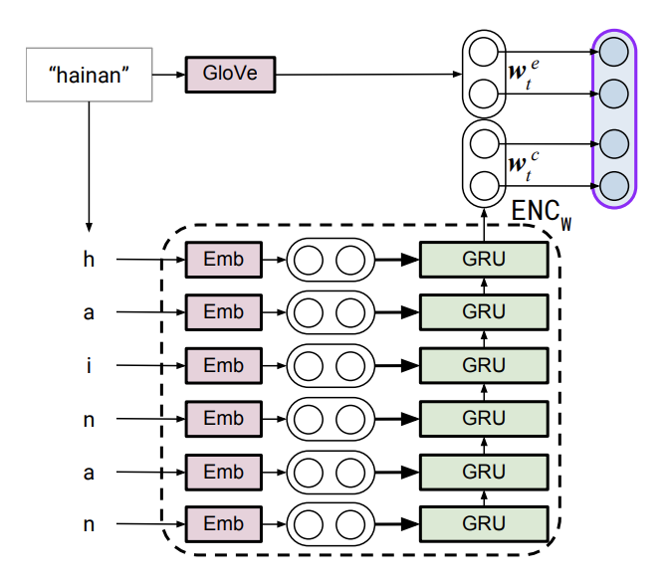
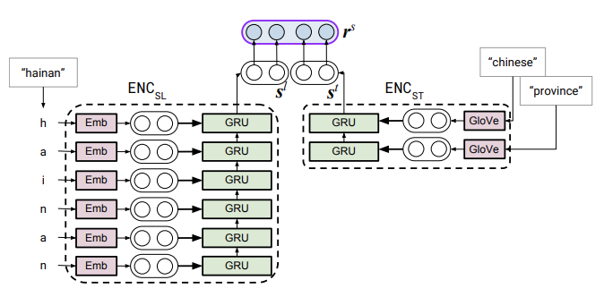
Related work
Hierarchical word/char-level Encoder ( Lukovinikov et al., 2017)
r_{q} = (r_{q}^{s}, r_{q}^{p})
_{Sp(q,p)} = cos(r_{q}^{p}, r^{p})
_{Ss(q,s)} = cos(r_{q}^{s}, r^{s})
r^{p}
/meteorology
GRU
Glove
GRU
Glove
/affected
GRU
Glove
_area
encoding_each word
GRU
Glove
/cyclone
hainan chinese province
meteorology/affected_area/cyclone
What cyclone affected Hainan?
Subject_encoding
Predicate_encoding
Question Encoding
KB_Facts Encoding
A Scheme For Factoid Question Answering over Knowledge Base
March 6, 2019

Slide 13
Objective
Examine the necessity of complex models for simple QA
Explore simple and strong baseline methods that achieve reasonable performance on the simple QA task.
A Scheme For Factoid Question Answering over Knowledge Base
March 6, 2019

Slide 14
Approach

Slide 15




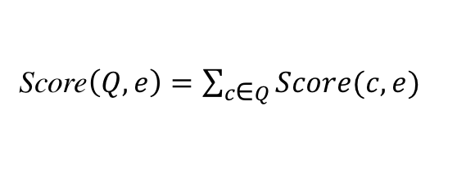
Proposed Approach
Score$\left(Q, e\right)=\sum_{c\text{∈} Q}^{ }{Score(c, e)}$
$$\underset{e^{′}}{argmax} \max_{\left(e −r − e^{′}\right)∈\text{I}\text{reach} }Score(Q,e){ }$$
e| r | $e^{′}$
Score$\left(c, e\right)=\max{\text{n}\text{∈}N(c)} BM25(n, e)$
fact
Entity detection
Entity Linking
List(e, Score$\left(Q, e\right))$
Question
Entity: I Relation: r
Filtering
Relation classification
Structured
query
I_{inv}
I_{reach}
Inverted Index
Reachability Index
Knowledge Base
Build Index
Subj| rel | Obj
A Scheme For Factoid Question Answering over Knowledge Base
March 6, 2019

Slide 16


Approach: Entity detection - RNN
where
was
Barack
Obama
born
Embedding layer
Hidden layer
RNN (BiLSTM/BiGRU)
Fully Connected layers
0
0
I
I
0
I : Entity
0 : Non-entity
A Scheme For Factoid Question Answering over Knowledge Base
March 6, 2019

Slide 17
Approach: Entity detection - CRF
Conditional Random Field: A conditional sequence model that represents the probability of a hidden state sequence given some observation
Stanford Named Entity Recognizer (NER):
Sequence labels: 4 classes
Person, Organization, Location, not-entity
We considered:
Entity : (Person, Organization, Location)
Two Classes : Entity
: Non-entity
A Scheme For Factoid Question Answering over Knowledge Base
March 6, 2019

Slide 18
Approach: Relation Classification - RNN
where
was
Barack
Obama
born
Embedding layer
Hidden layer
RNN (BiLSTM/BiGRU)
Fully Connected layers
People/person/place_of_birth
A Scheme For Factoid Question Answering over Knowledge Base
March 6, 2019

Slide 19
Approach: Relation Classification - CNN
CNN for sentence classification (Kim et al 2014)
k
x_{1:n} = x₁⌖ x₂ ⌖ ,…, ⌖ x_{n,} (1)
h
c_{i} = f(W. x_{i:i + h-1} + b). (2)
c = [c₁, c₂, …, c_{n-h+1}]. (3)
n
People/person/place_of_birth
nxk question
representation
Convolutional layer filter width & feature
maps
max-over-time pooling
Fully connected layer with
dropout and softmax output
n: question length
k: word vector dimension
h: word window size
A Scheme For Factoid Question Answering over Knowledge Base
March 6, 2019
Notes:
We also apply CNN for relation prediction, We adopt the sentence classification CNN architecture from Kim et al as 2014 paper.
We represent the sentence by concatenating words and padding where necessary as shown in equation 1.
And we use convolutional filters to generate new features from a window of words as represented by equation 2.
We apply the filter to each of the possible window of words in the sentence to produce a feature map represented by equation 3.
We then use the max-over-time pool over the filter to take the maximum value as a feature corresponding to this particular filter.
The idea is to capture the most important feature, which is basically one with the highest value for each feature map.
And finally these features are passed on to the fully connected softmax layer whose output is the probability distribution over labels.

Slide 20
Approach: Entity linking – Creating the Inverted Index
e1: max{tfidf(“Barack Obama”, e1), tfid(“Obama”, e1), tfid(“Barack”, e1)}
= tfid(“Barack Obama”, e1)
= Score(n=2, tf=2/3, df=0.001)
e2: score(n=1, tf=1/2, df=0.01)
e3: score(n=1, tf=1, df=0.1)
Entity detection
Question
Entity: “Barack Obama” Relation: bornOn
Entity Linking
Relation classification
Structured
query
I_{inv}
Question
e₁
e₂
“How old is Barack Obama?”
Michelle Obama Barack (Person)
Sasha
Obama (Person)
Barack
e₃
Obama (president)
n-grams
Barack Obama
Obama
A Scheme For Factoid Question Answering over Knowledge Base
March 6, 2019

Slide 21
Approach: Entity linking – Creating the Reachability Index
e₄: 0.9
e₆: 0.3
fact
Relation = bornOn
Entity detection
Candidates = [<e₁,0.9>, <e₂,0.3>, <e₃,0.6>]
Question
Entity: “Barack Obama” Relation: bornOn
Entity Linking
Filtering
Relation classification
Structured
query
I_{reach}
Question
e₁
e₂
“How old is Barack Obama?”
Michelle Obama Barack (Person)
Sasha
Obama (Person)
e₅
presidentOf
bornOn
United_states
e₃
e₄
bornOn
Obama (president)
6/10/2001
8/4/1961
e₆
A Scheme For Factoid Question Answering over Knowledge Base
March 6, 2019

Slide 22
Results

Slide 23
Experimental set up
Table 1: Simple question dataset Statistics
Table 2: Knowledge base Statistics
A Scheme For Factoid Question Answering over Knowledge Base
March 6, 2019

Slide 24
Results: Entity detection and linking
Table 3: Entity detection
Table 4: Entity linking
A Scheme For Factoid Question Answering over Knowledge Base
March 6, 2019

Slide 25
Results: Relation Prediction
Table 5: Relation Prediction
A Scheme For Factoid Question Answering over Knowledge Base
March 6, 2019

Slide 26
Results: End-to-end combination
A Scheme For Factoid Question Answering over Knowledge Base
March 6, 2019

Slide 27
Results: Comparison
A Scheme For Factoid Question Answering over Knowledge Base
March 6, 2019

Slide 28
Conclusion and Future work.

Slide 29
Conclusion
We explore simple yet effective approach for Simple question answering
There is still need to adequately examine simple baselines rigorously before rushing to sophisticated deep learning techniques at least for Simple QA.
There is need to consider other non-neural network baselines in future
Consider more complex questions with joint knowledge sources.
A Scheme For Factoid Question Answering over Knowledge Base
March 6, 2019

Slide 30
Thank you Time for human Question Answering! 😉

